Slide 1


Cuneyt Harputluoglu
20.11.2023

Slide 2

Outline
Executive Summary
Introduction
Methodology
Results
Conclusion
Appendix

Slide 3
Executive Summary
Summary of methodologies
Data collection
Data wrangling
EDA with data visualization
EDA with SQL
Building an interactive map with Folium
Predictive analysis
Summary of all results
EDA results
Predictive analysis

Slide 4
Introduction
Project background and context
Spacex advertises Falcon 9 rocket launches in its webpage, with a cost of 62M $ but competitors with a cost of 165M$/each.Success is because of reusable first stage module.
Problems you want to find answers
Project task is to predict if the future first stage of the SpaceX Falcon9 rocket will land successfully or not

Slide 5

Section 1

Slide 6
Methodology
Executive Summary
Data collection methodology:
Data collected over SpaceX API
Webscraping over Wikipedia
Perform data wrangling
One hot encoding data for ML and data cleaning,new field generation for ML
Perform exploratory data analysis (EDA) using visualization and SQL
Perform interactive visual analytics using Folium and Plotly Dash
Perform predictive analysis using classification models
Logistic Reg., KNN, SVM and DecisionTree were performed to find the best predictor

Slide 7
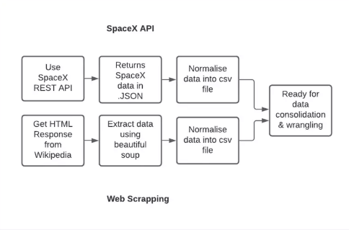
Data Collection
Data were collected from SpaceX API
API gives many useful info about launches with rocket used,payload,launch specs, Landing specs and outcome data.
REST API endpoints, or URL starts with «https://api.spacexdata.com/v4/»
For webscraping, BeautifulSoup was used to scrape wikipedia.
Process flow is illustrated at right.

Slide 8
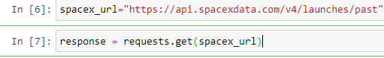
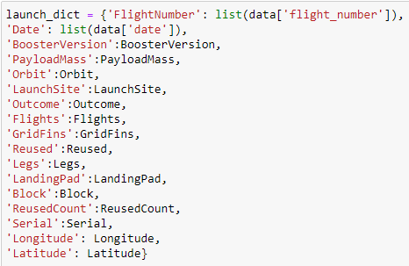
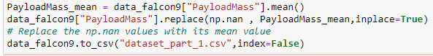
Data Collection – SpaceX API
Request for connection to API and DF creation
Data preparation is explained on right side.
https://github.com/cuneytharp/testrepo/blob/main/jupyter-labs-spacex-data-collection-api.ipynb
Dataset construction dictionary
Filtering Falcon-9 data and filling nan values with mean

Slide 9
Data Collection - Scraping
Request and get response from HTML
Create BeautifulSoup object
Find Tables
Get column names
Create an empty dictionary
Append data to dictionary
Create df from dictionary
DF to .CSV
Web Scraping from Wiki
https://github.com/cuneytharp/testrepo/blob/main/jupyter-labs-webscraping.ipynb

Slide 10
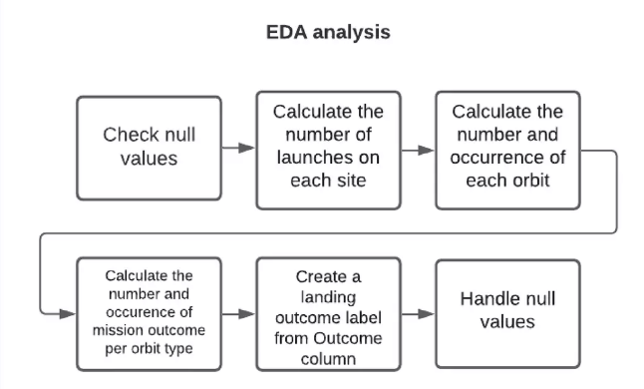
Data Wrangling
Data Wrangling process is as illustrated at below.
https://github.com/cuneytharp/testrepo/blob/main/labs-jupyter-spacex-data_wrangling_jupyterlite.jupyterlite.ipynb

Slide 11
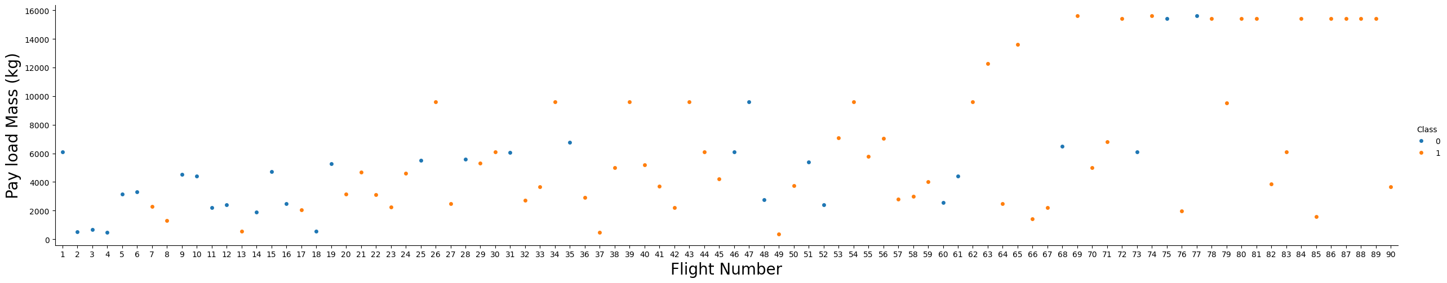
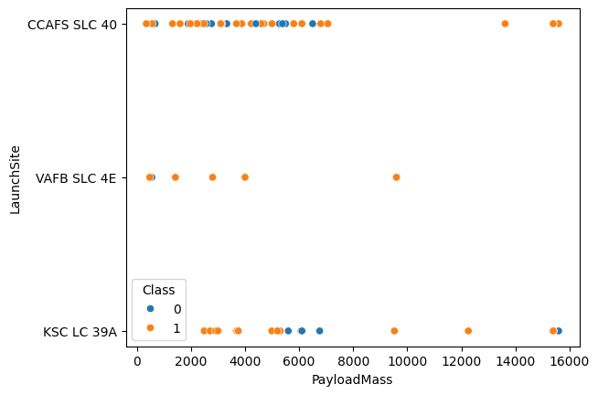
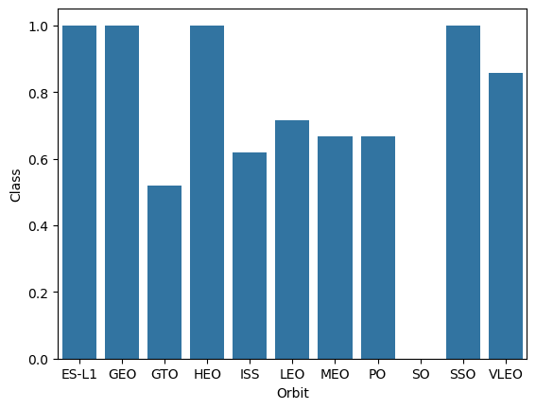
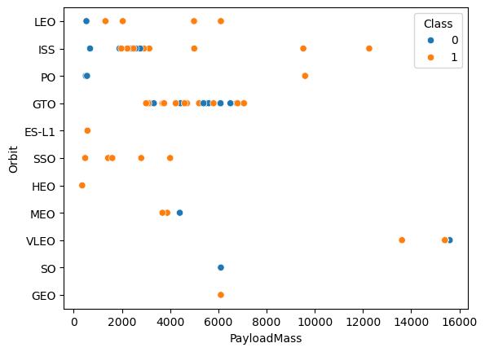
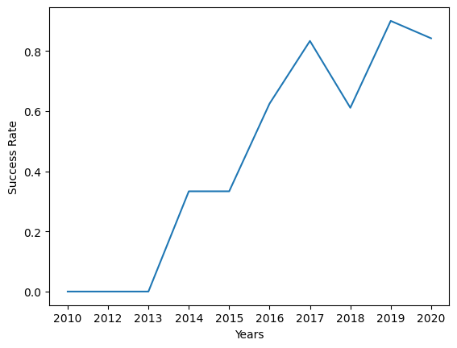
EDA with Data Visualization
Catplot was used to present flightnumber/payload and payloadmass/launchSite relation.Barchart was used to show orbit based success rates(1=100%).Scatterplot was used to show payloadmass and orbit relation.Lineplot was used to show yearly success rate
https://github.com/cuneytharp/testrepo/blob/main/jupyter-labs-eda-dataviz.ipynb.jupyterlite.ipynb

Slide 12
EDA with SQL
Display the names of the unique launch sites in the space mission
%sql select DISTINCT launch_site from SPACEXTABLE
Display 5 records where launch sites begin with the string 'KSC'
%sql select * from SPACEXTABLE WHERE launch_site LIKE 'KSC%' LIMIT 5
Display the total payload mass carried by boosters launched by NASA (CRS)
%sql SELECT sum(PAYLOAD_MASS__KG_) from SPACEXTABLE WHERE Customer LIKE "NASA (CRS)"
Display average payload mass carried by booster version F9 v1.1
%sql SELECT AVG(PAYLOAD_MASS__KG_) from SPACEXTABLE WHERE Booster_Version = "F9 v1.1"
List the date where the succesful landing outcome in drone ship was acheived.
%sql SELECT Date FROM SPACEXTABLE WHERE Landing_Outcome ="Success (drone ship)"
List the names of the boosters which have success in ground pad and have payload mass greater than 4000 but less than 6000
%sql SELECT Booster_Version FROM SPACEXTABLE WHERE Landing_Outcome ="Success (ground pad)" AND PAYLOAD_MASS__KG_>4000 AND PAYLOAD_MASS__KG_<6000
List the total number of successful and failure mission outcomes
%sql SELECT COUNT(Mission_Outcome) as "Successful Mission" FROM SPACEXTABLE WHERE Mission_Outcome ="Success"
%sql SELECT COUNT(Mission_Outcome) as "Failed Mission" FROM SPACEXTABLE WHERE Mission_Outcome !="Success"
https://github.com/cuneytharp/testrepo/blob/main/jupyter-labs-eda-sql-edx_sqllite.ipynb

Slide 13
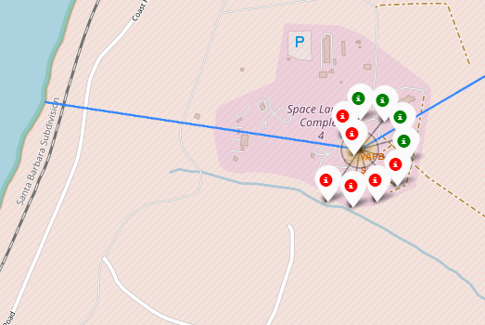
Build an Interactive Map with Folium
Markers, circles, cluster were used to visualize data. Mouseposition was used to get coordinates where mouse hovers. Polyline was used to show distance between coastline and launch site.Coloring data was gathered by a written function.
https://github.com/cuneytharp/testrepo/blob/main/lab_jupyter_launch_site_location.jupyterlite.ipynb

Slide 14
Build a Dashboard with Plotly Dash
Summarize what plots/graphs and interactions you have added to a dashboard
Explain why you added those plots and interactions
Add the GitHub URL of your completed Plotly Dash lab, as an external reference and peer-review purpose

Slide 15
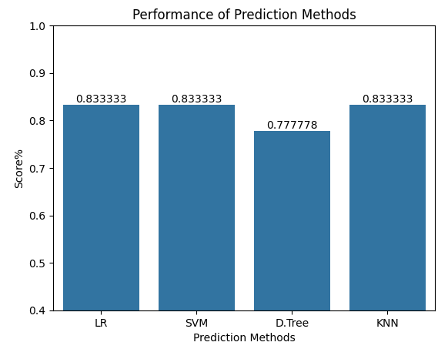
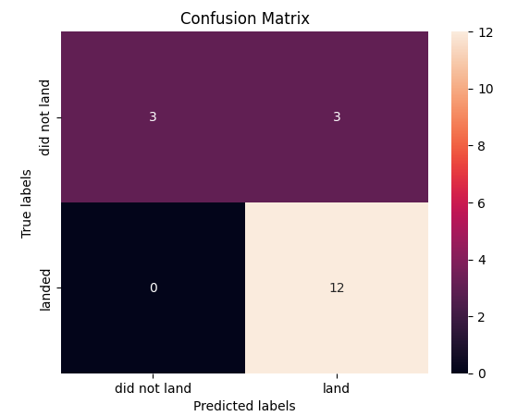
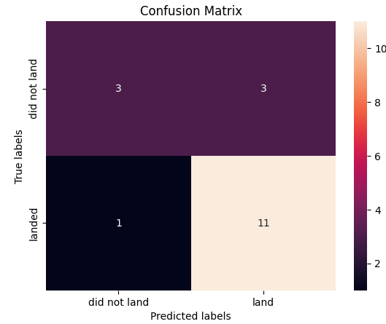
Predictive Analysis (Classification)
Logistic regression, decision tree, KNN and SVM methods were performed and %83.3 accuracy could be achieved .
GridsearchCV was used for hyperparameter tuning with unique specified parameter lists.
D.Tree

Slide 16
Results
SVM,KNN and Logistic Regression models are best performing models for this data set(%83.3)
As seen, success rate of SpaceX is increasing continuously which may mean we can expect better success rates in future.
GEO,HEO,SSO, and ES L1 orbits have the best success rate.
All launch sites are near to ocean

Slide 17

Section 2

Slide 18
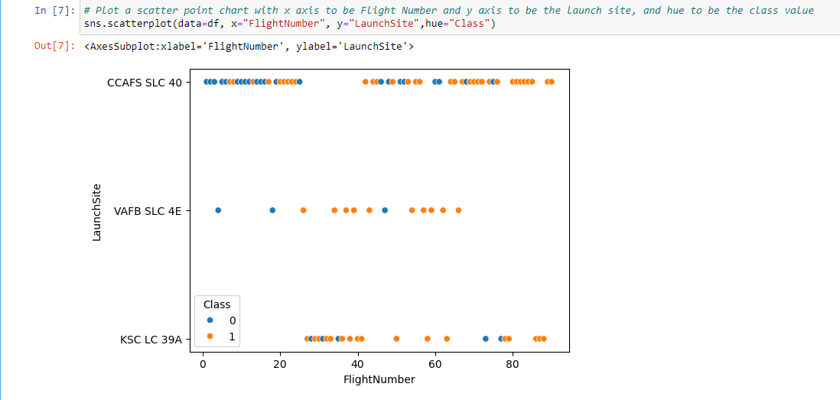
Flight Number vs. Launch Site
Show a scatter plot of Flight Number vs. Launch Site
Show the screenshot of the scatter plot with explanations

Slide 19
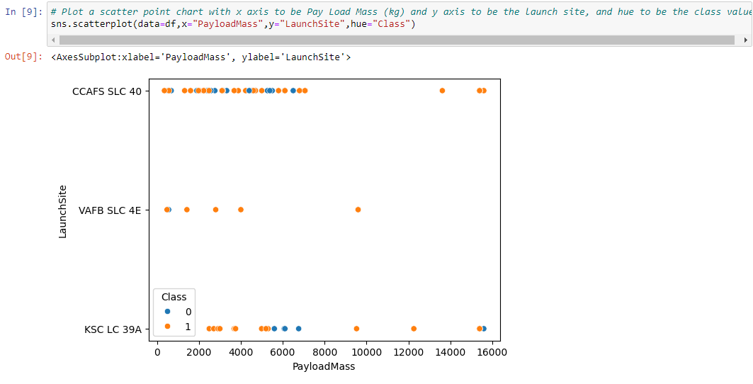
Payload vs. Launch Site
Show a scatter plot of Payload vs. Launch Site
Show the screenshot of the scatter plot with explanations

Slide 20
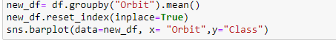
Success Rate vs. Orbit Type(Class, 1=100%)

Slide 21
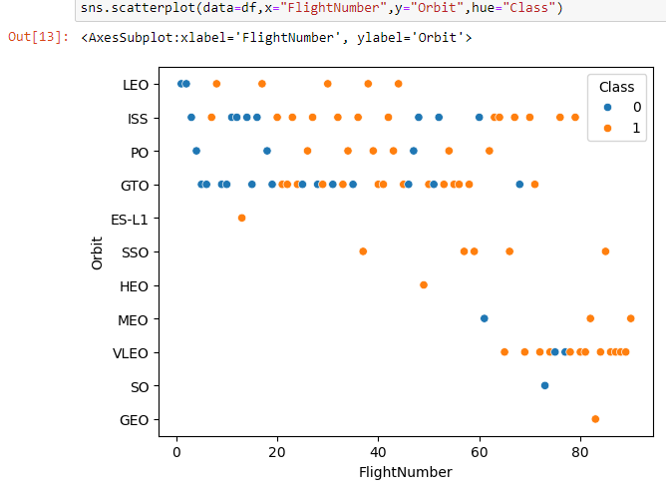
Flight Number vs. Orbit Type
Show a scatter point of Flight number vs. Orbit type
Show the screenshot of the scatter plot with explanations

Slide 22
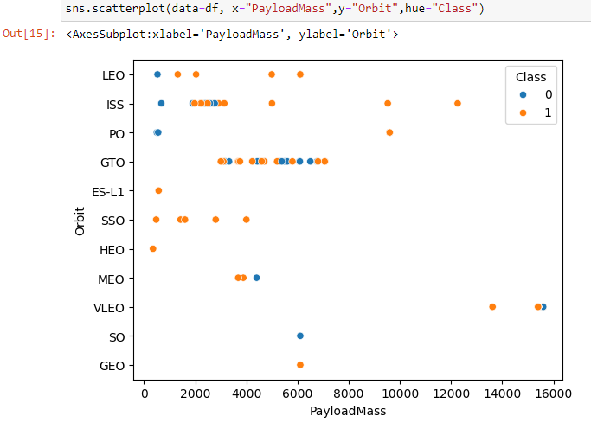
Payload vs. Orbit Type
Show a scatter point of payload vs. orbit type
Show the screenshot of the scatter plot with explanations
Success increases with payload over 10000kg

Slide 23
Launch Success Yearly Trend
Show a line chart of yearly average success rate
Show the screenshot of the scatter plot with explanations
After 2013, there is significant improvement in success rate

Slide 24
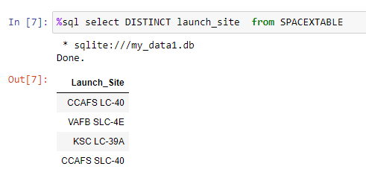
All Launch Site Names
Query with «DISTINCT» parameter gets unique values of the column like df[x].unique()

Slide 25
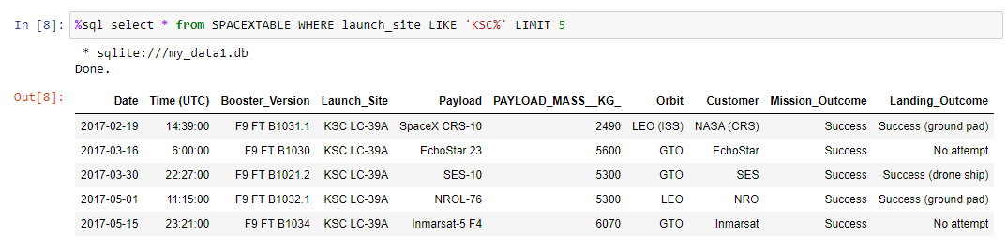
Launch Site Names Begin with 'KSC'
LIMIT describes how many results will be returned from query.
LIMIT 5 is similiar to df.head()

Slide 26
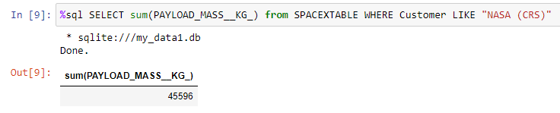
Total Payload Mass
Sum function within query sums the returned query for PAYLOAD_MASS_KG

Slide 27
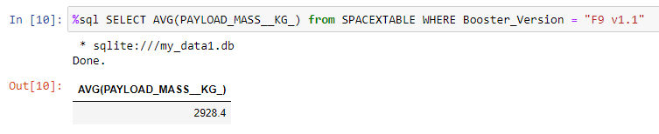
Average Payload Mass by F9 v1.1

Slide 28
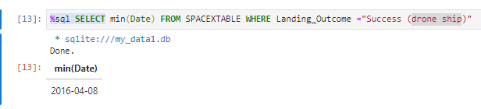
First Successful Ground Landing Date
Min function returns the minimum value of the specified field. We also filter landing outcome by «Success (drone ship)»
With min, we return the earliest success.

Slide 29
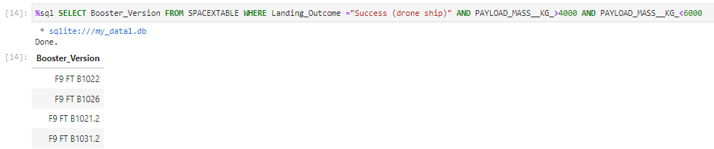
Successful Drone Ship Landing with Payload between 4000 and 6000
After WHERE Clause we can specify our filters and join them by AND operation for filtering.

Slide 30
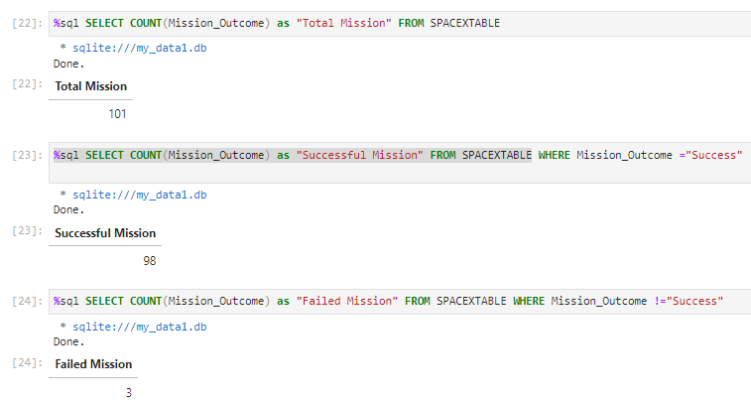
Total Number of Successful and Failure Mission Outcomes
With «as», we can specify column name. Count gathers the count number of the specified column. We can distinguish them by filtering according to the success condition of the outcome.

Slide 31
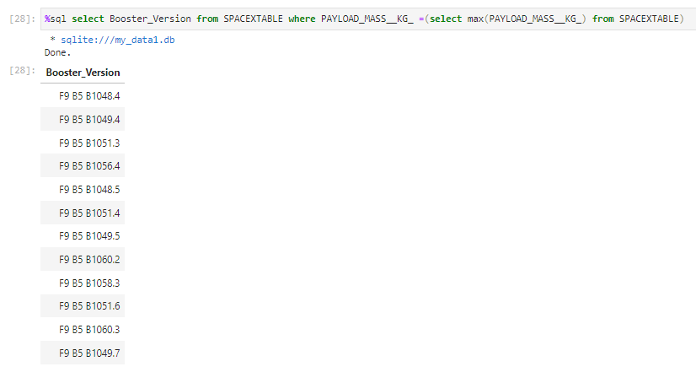
Boosters Carried Maximum Payload

Slide 32
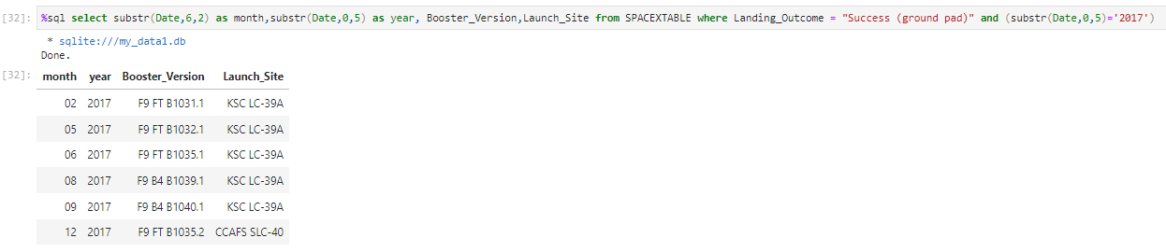
2015 Launch Records
As seen , KSC LC-39A seems a very good launch site matching these conditions

Slide 33
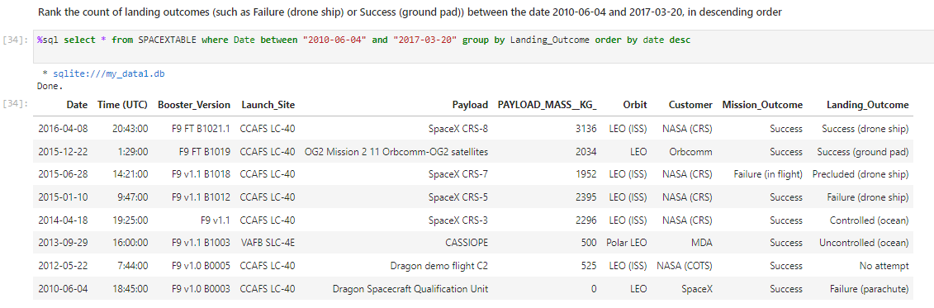
Rank Landing Outcomes Between 2010-06-04 and 2017-03-20
Rank the count of landing outcomes (such as Failure (drone ship) or Success (ground pad)) between the date 2010-06-04 and 2017-03-20, in descending order
Present your query result with a short explanation here

Slide 34

Section 3

Slide 35
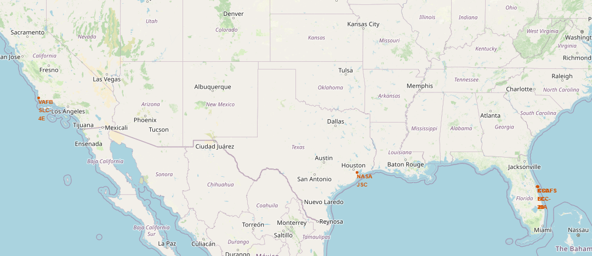
Launch sites of SpaceX
As seen, all launch sites are near to ocean for safety reasons. If landing is unsuccessful, it will not harm any people located on residential areas.

Slide 36
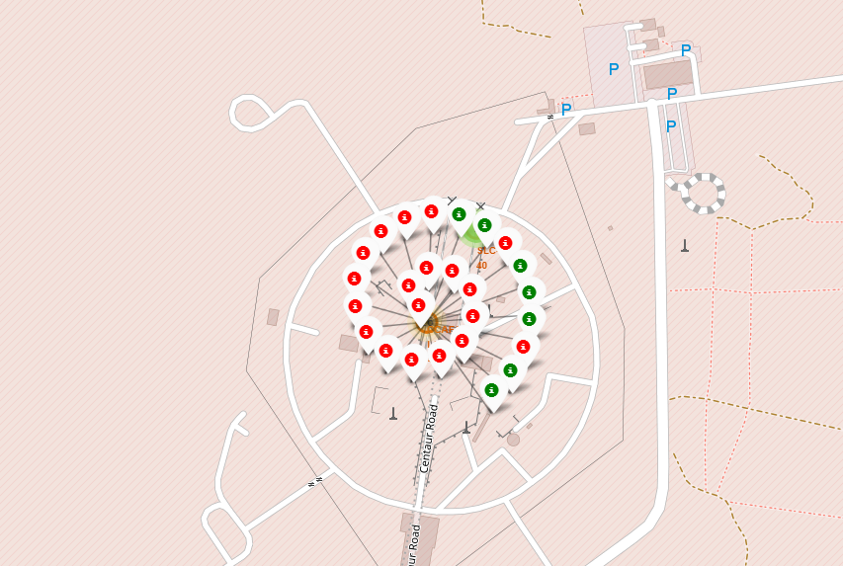
Outcomes from SLC-40
Red shows unsuccessful and green shows successful results

Slide 37
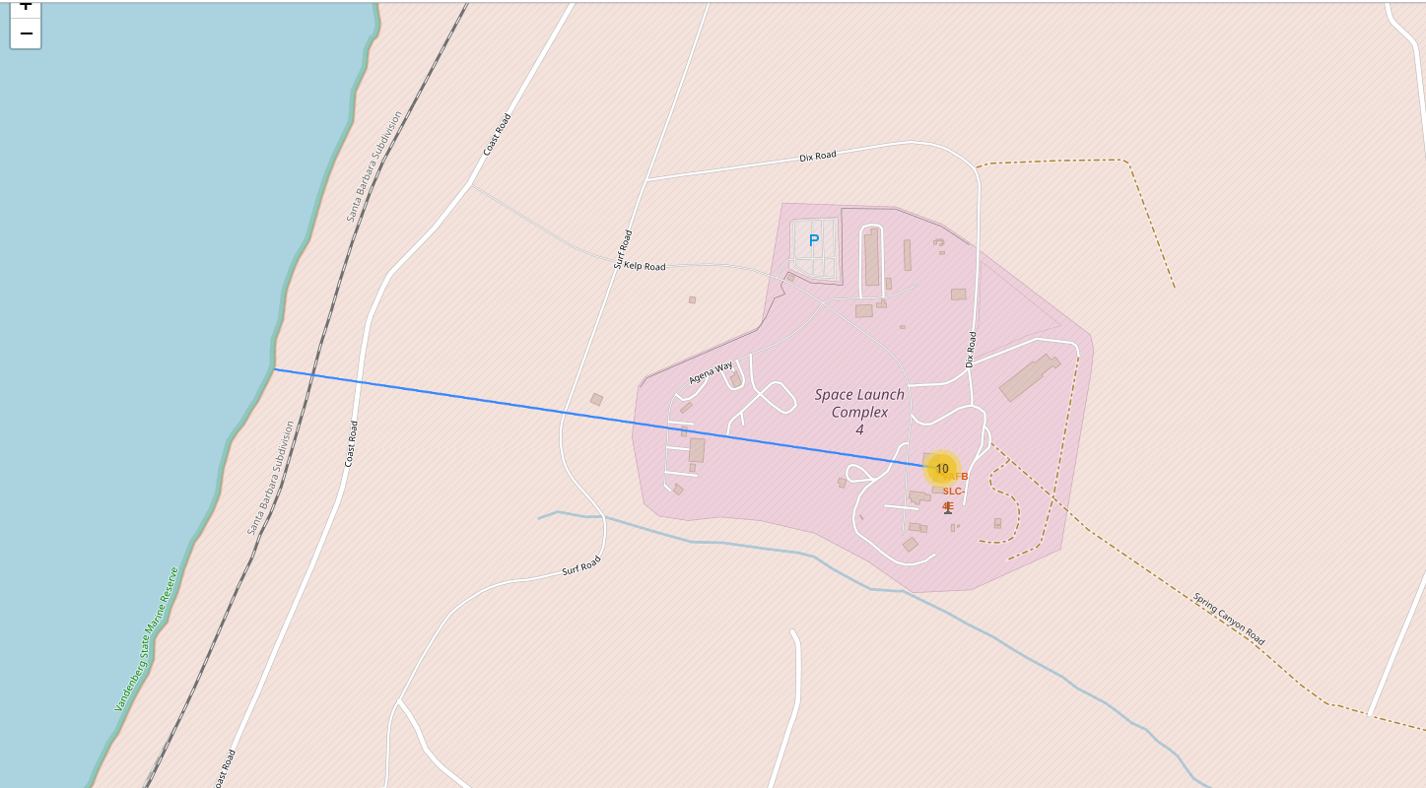
Distance from coastal line
Launch site is 1.34km away from coastal side.

Slide 38

Section 4

Slide 39
<Dashboard Screenshot 1>
Replace <Dashboard screenshot 1> title with an appropriate title
Show the screenshot of launch success count for all sites, in a piechart
Explain the important elements and findings on the screenshot

Slide 40
<Dashboard Screenshot 2>
Replace <Dashboard screenshot 2> title with an appropriate title
Show the screenshot of the piechart for the launch site with highest launch success ratio
Explain the important elements and findings on the screenshot

Slide 41
<Dashboard Screenshot 3>
Replace <Dashboard screenshot 3> title with an appropriate title
Show screenshots of Payload vs. Launch Outcome scatter plot for all sites, with different payload selected in the range slider
Explain the important elements and findings on the screenshot, such as which payload range or booster version have the largest success rate, etc.

Slide 42

Section 5

Slide 43
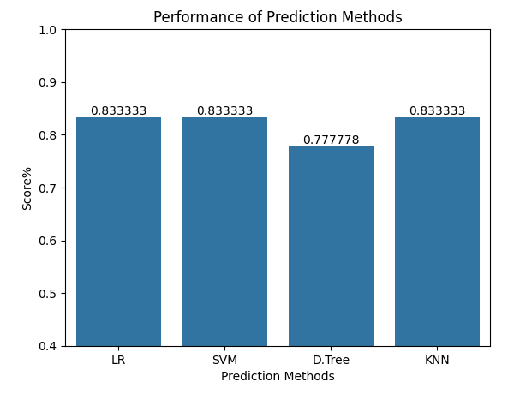
Classification Accuracy
As seen, logistic regression,support vector machines and KNN both perform the same.

Slide 44
Confusion Matrix
Prediction is very accurate on landed outcomes.

Slide 45
Conclusions
SVM,KNN and Logistic Regression models are best performing models for this data set
As seen, success rate of SpaceX is increasing continuously which may mean we can expect better success rates in future.
GEO,HEO,SSO, and ES L1 orbits have the best success rate.
All launch sites are near to ocean.

Slide 46


